Slide 1
Communicating Results

Slide 2
Lab 4: your 5-7 things
Communicating with data
Really common visualisations
Quite common visualisations
Visualisation tools: Matplotlib and Tableau
Doing more: D3 and beyond

Slide 3
Communicating with Data

Slide 4
Engage your audience
Who are these people?
Demographics: which languages? What red flags?
What communications styles are they used to?
What channels are you using? Website, printed media, SMS?
What have you got for them?
Insights? answers? surprises?
Exploring or explaining?
Do you want to engage, persuade, inform or entertain?
What do they already know?
Why should they care?
Notes:
Red flags: things you really need to be careful of. For example: using orange and green for an Irish audience.

Slide 5
Design rules
Storytelling:
Design for your medium (e.g paper)
Learn from the storytellers: have a beginning, middle and end
Use drill-down: summarise with visuals, but allow users to reach the data
Frame your message - why are you doing this, how did you get here
Visualisations:
Have graphical integrity (e.g. start bars at zero)
Keep your charts simple: maximise the data:ink ratio
Use the right chart type for the data
No more than 5-8 colours per visualisation (see colorbrewer2.org)
Notes:
See http://extremepresentation.typepad.com/blog/files/choosing_a_good_chart.pdf for advice on choosing the right chart type..
Sometimes it’s appropriate to throw data and graphs at the user, and let them work it out on their own, but usually drill-down and a story is the answer.
See Alberto Cairo’s work for more details.

Slide 6
Really Common Visualisations

Slide 7
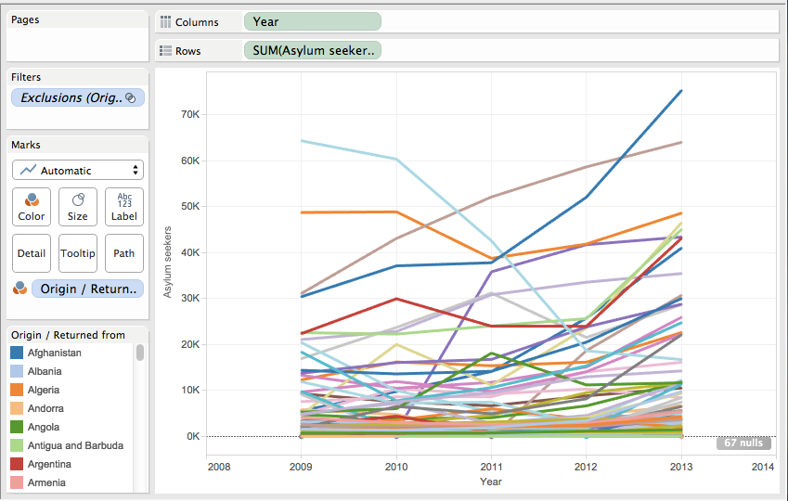
Multi-Line graph
Notes:
All these examples are in Tableau Gallery here: https://public.tableau.com/profile/sara.terp#!/vizhome/DS_session_example/exampledashboard and in Tableau Desktop here: https://github.com/bodacea/inafu6513/blob/master/Notebooks/4.2 Tableau_example.twb

Slide 8
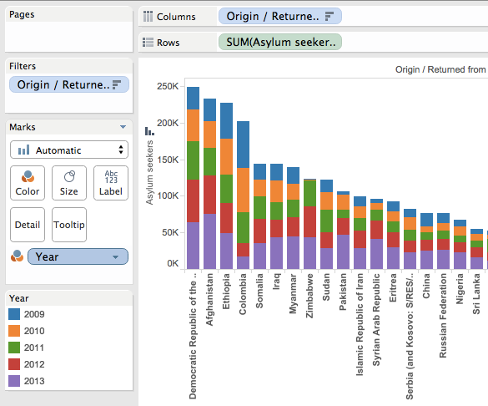
Stacked Column Chart

Slide 9
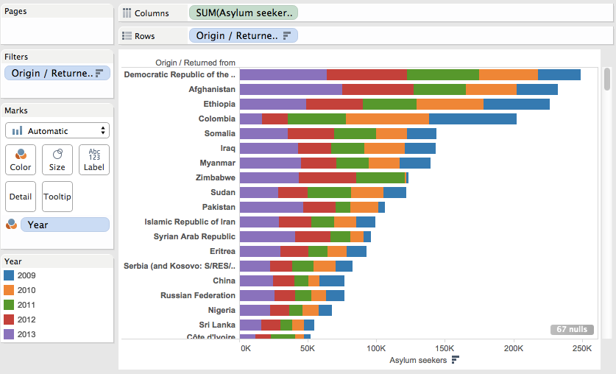
Stacked Barchart

Slide 10
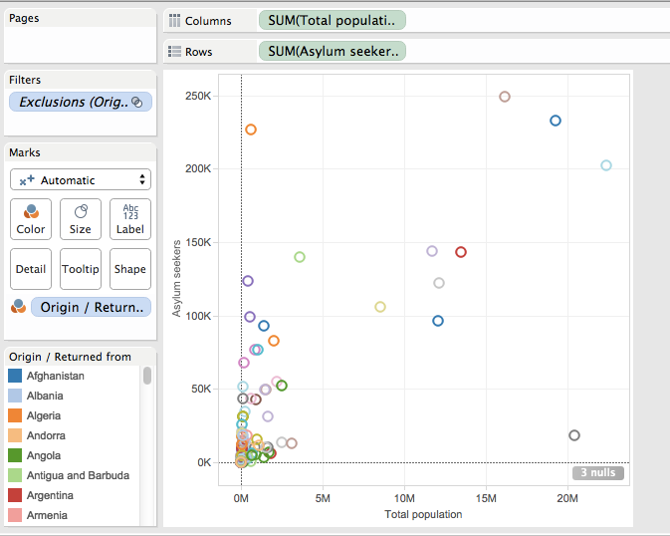
Scatterplot

Slide 11
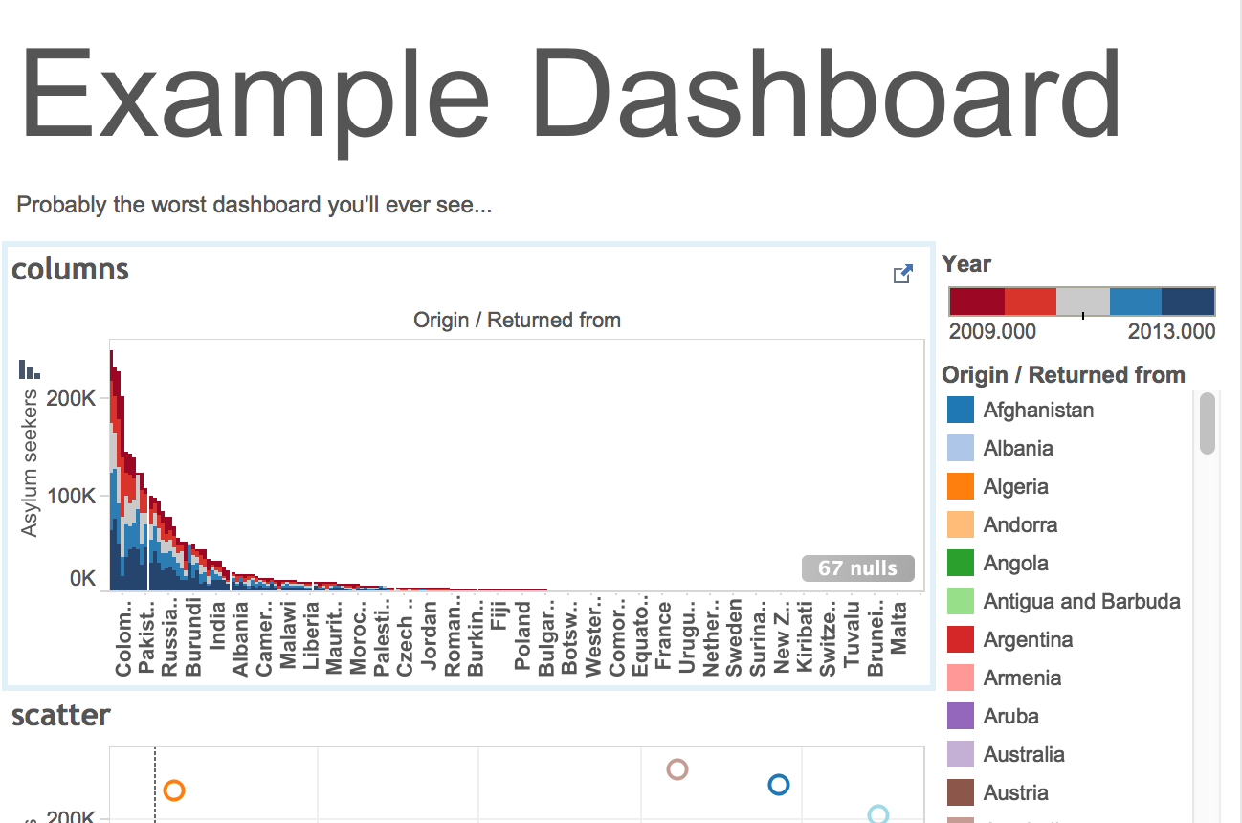
Dashboards
Notes:
You can put visualisations and text together in a dashboard. You can also link these visualisations, so that when you click on a point in one visualisation, data relevant to that point is shown in another.

Slide 12
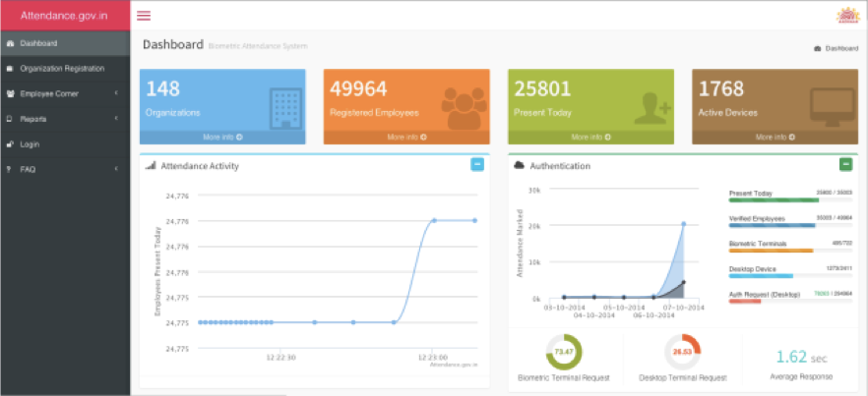
Dashboards
Notes:
This is india’s government employee attendance dashboard. If you look at the bottom of Tableau, there’s a dashboard button.

Slide 13
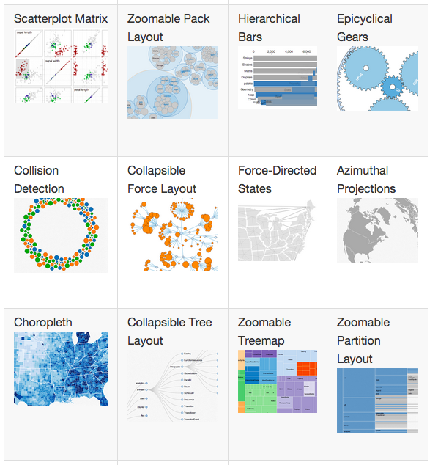
More visualisation types
Notes:
Other visualisation types you’ll see a lot include Chord diagram, Sankey diagram, Choropleth, symbol map

Slide 14
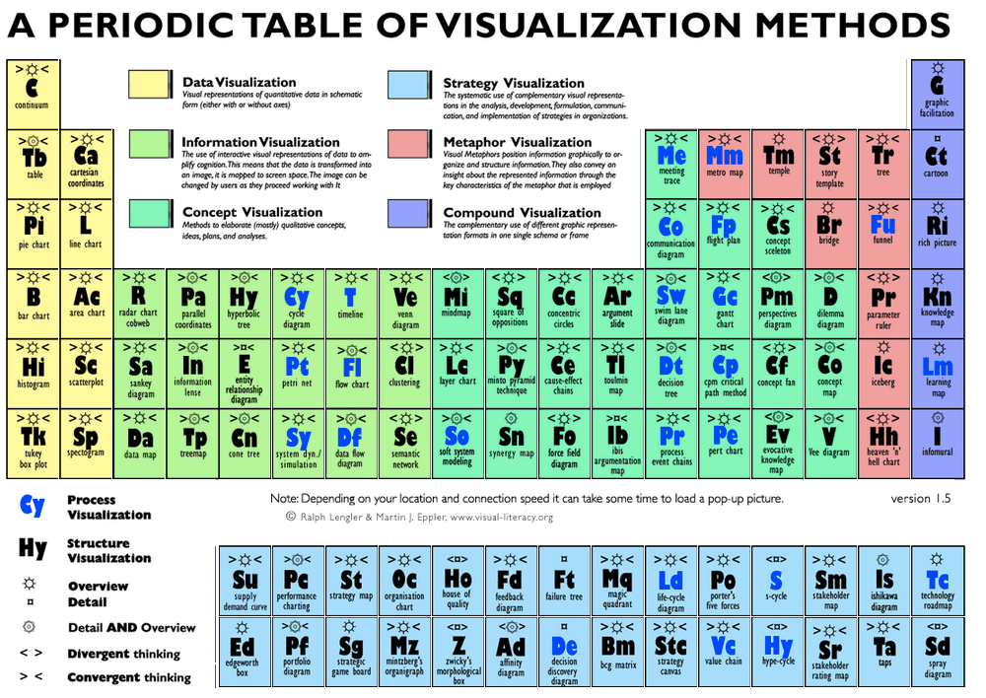
Name That Visualisation!
Notes:
http://www.visual-literacy.org/periodic_table/periodic_table.html

Slide 15
Common Visualisation Tools

Slide 16
Choosing a Visualisation Tool
What do you want to do?
Standard visualisations, or something special?
Inputs: files (e.g. CSV) or streaming data? Maps?
Non-roman languages (Arabic, Mandarin etc)?
Interactive or static?
Where do you want to do it?
Online or offline?
Any other restrictions?
Third-party visible or private?
Free, cheap or expensive?
Ease of use (and support!)

Slide 17
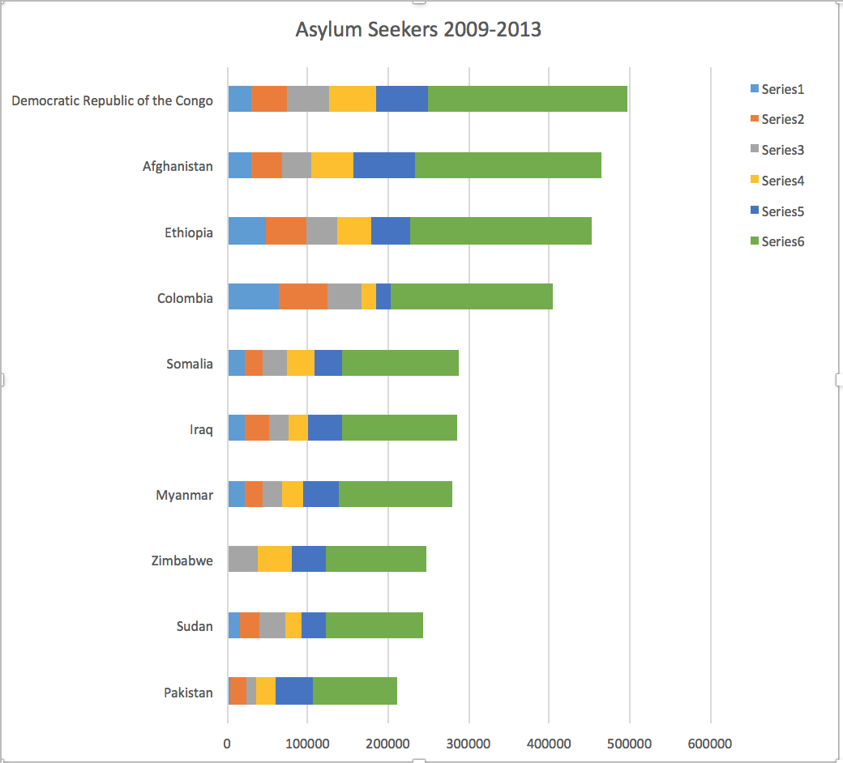
Excel
Limited set of visualisation types
Not interactive
Offline
Static
Not free
Relatively easy
Widely used
Notes:
To create this chart: copied the asylum seeker data into an excel spreadsheet. Created a pivot table from the data. Created a chart from the pivot table. Did lots of fussing around to get chart elements in the right place/ filtered. Still more fussing needed to get e.g. the legend right.

Slide 18
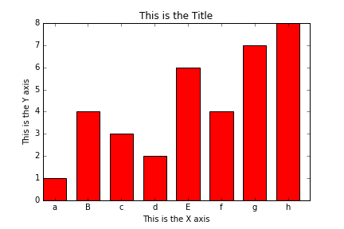
Matplotlib
Python visualisation library
Not interactive
Not the prettiest (but does have ways to make it prettier, e.g. Seaborn)
Good for quick-and-dirty views of data
Offline + Online
Free

Slide 19
Tableau
Tableau Public
Free
Interactive
Excel or text (CSV) import only
Public, and needs internet connection
Tableau Desktop
Not free (but free to students who ask)
Interactive
Range of import formats and datastore APIs
Private, and works offline

Slide 20
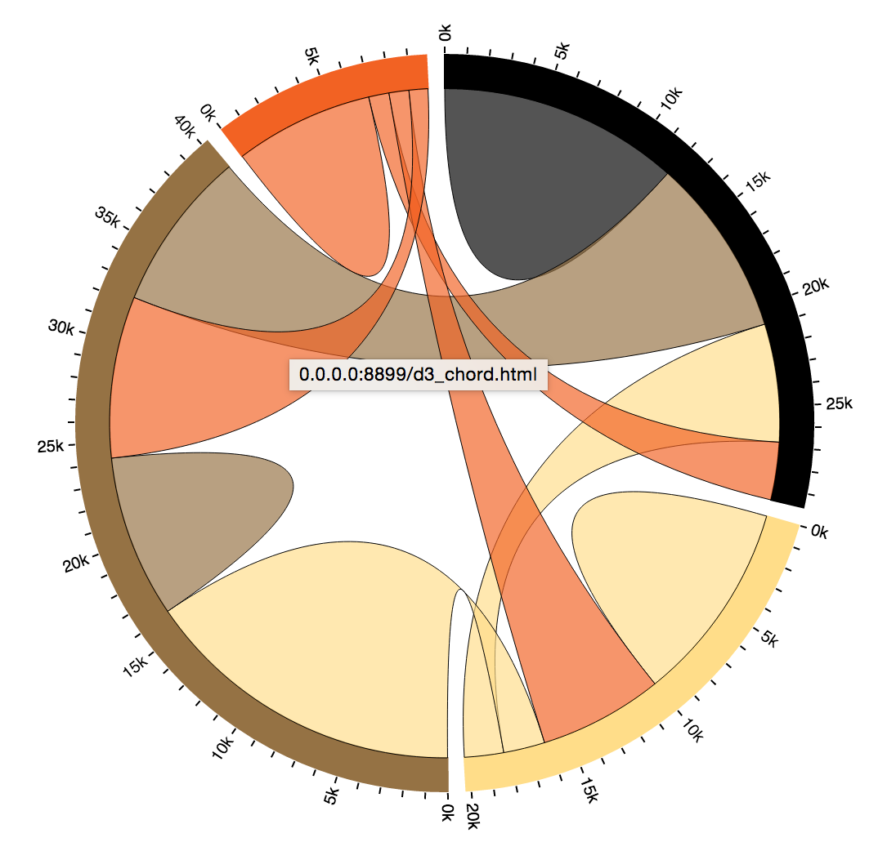
D3
Free
Interactive
Very very flexible = almost any diagram you want
Steep learning curve
Works offline

Slide 21

Other Common Tools
Piktochart
Google fusion tables
Ggplot
Highcharts
NVD3
Notes:
The image is one of the Piktochart templates. Infographics aren’t immediate outputs from python code, but can be very powerful.

Slide 22
Matplotlib and Tableau exercises

Slide 23
Exercise: draw a line chart in Matplotlib
%matplotlib inline
import matplotlib.pyplot as plt
import numpy as np
x = np.linspace(0, 10, 100)
y = np.sin(x)
plt.plot(x, y)
Notes:
NB: You only need the %matplotlib inline in an ipython notebook.

Slide 24
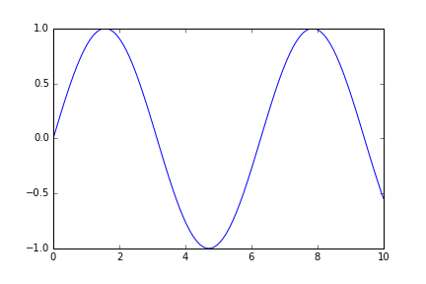
That line chart

Slide 25
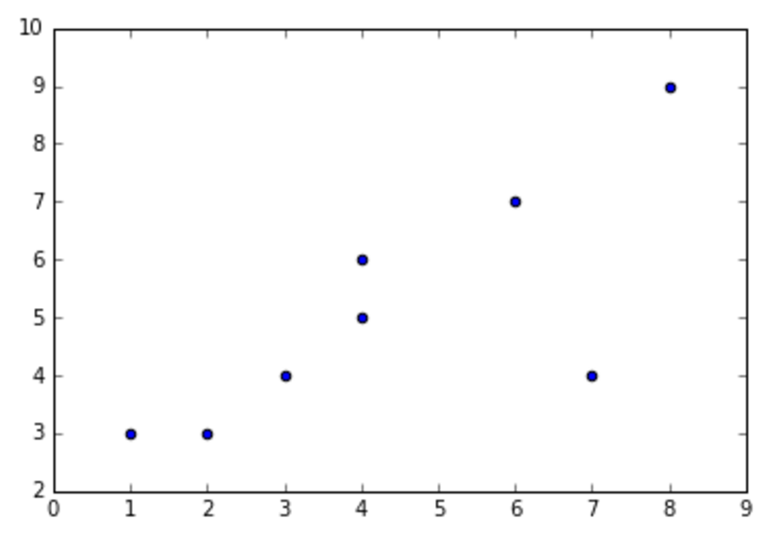
Exercise: draw a scatterplot
import matplotlib.pyplot as plt
import numpy as np
x = np.array([1,4,3,2,6,4,7,8])
y = np.array([3,5,4,3,7,6,4,9])
plt.scatter(x, y)

Slide 26
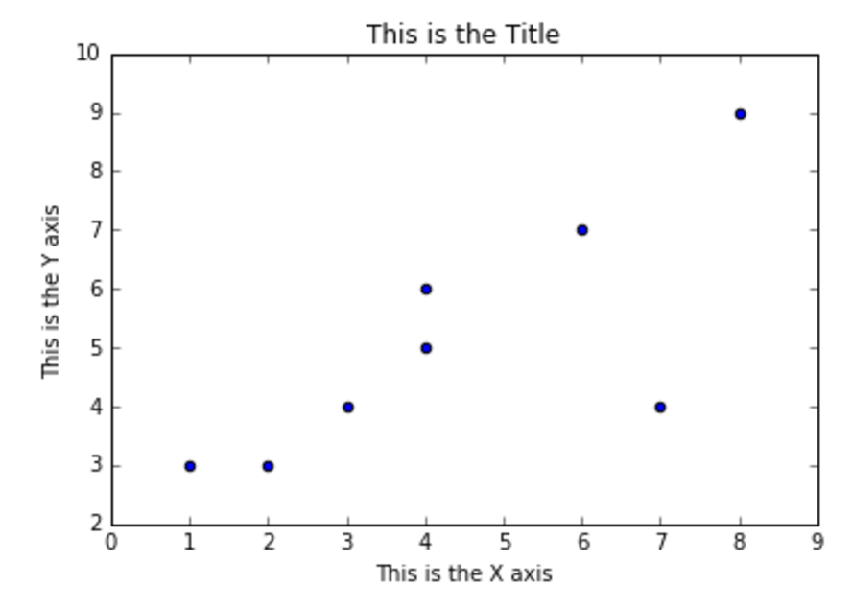
Add labels
fig, ax = plt.subplots()
plt.scatter(x, y)
ax.set_ylabel('This is the Y axis')
ax.set_xlabel('This is the X axis')
ax.set_title('This is the Title')
Notes:
plt.subplots creates a plot on your drawing ‘canvas’. It’s what we usually use to create a group of plots. Here, we’re using it to get at the axes (ax) for this visualisation.

Slide 27
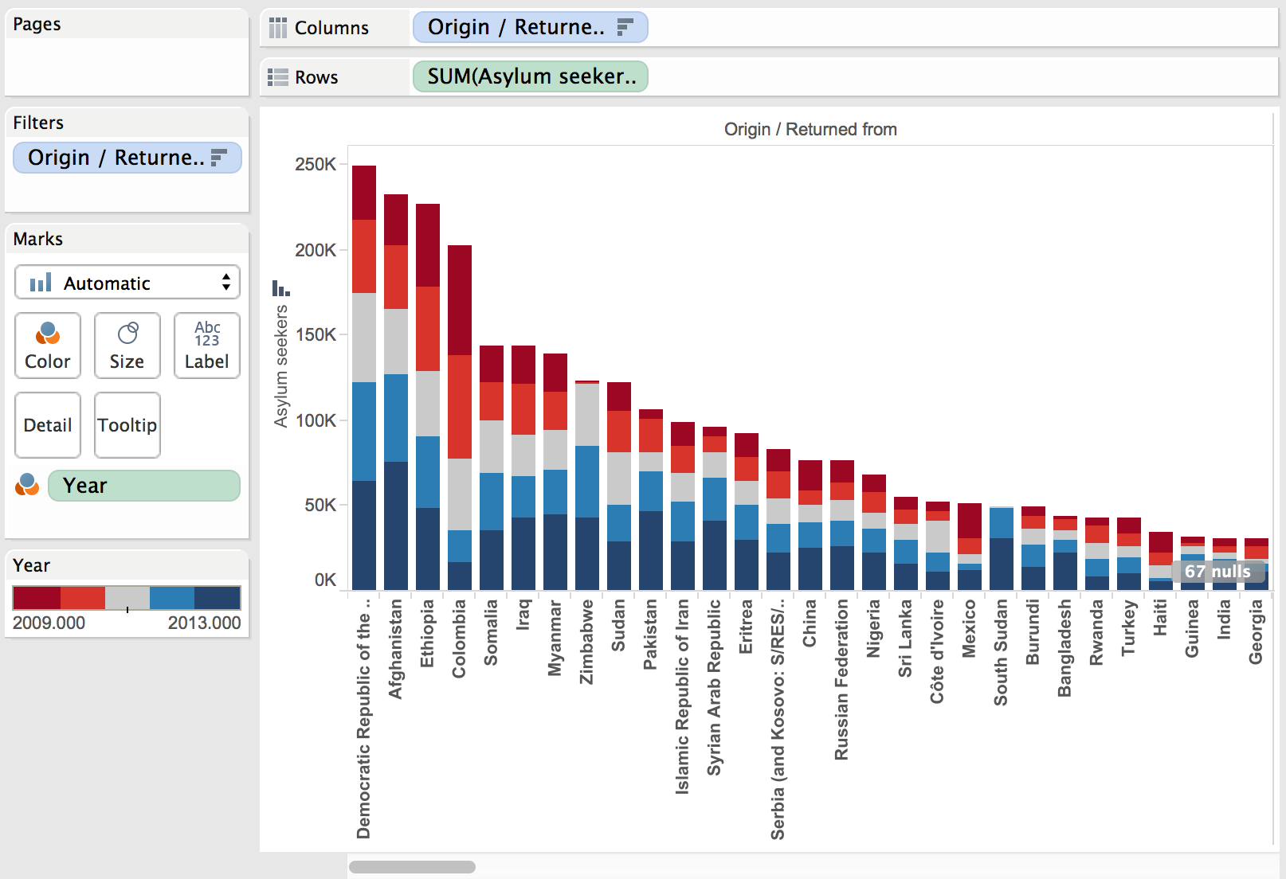
Exercise: Draw a stacked column chart in Tableau

Slide 28
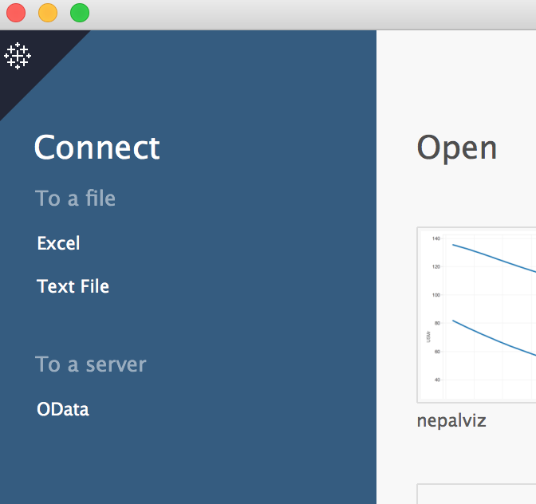
Do this: Import data into Tableau
Get a copy of example file “cleaned_popstats.csv”
Open Tableau Public (click on the executable)
Click on “Text File”
Select “cleaned_popstats.csv”, then “open”
Congratulations - you’ve got data into Tableau
Now click on “sheet 1” at the bottom of the page
Notes:
Data file is here is you get stuck: https://github.com/bodacea/inafu6513/blob/master/example_data/cleaned_popstats.csv

Slide 29
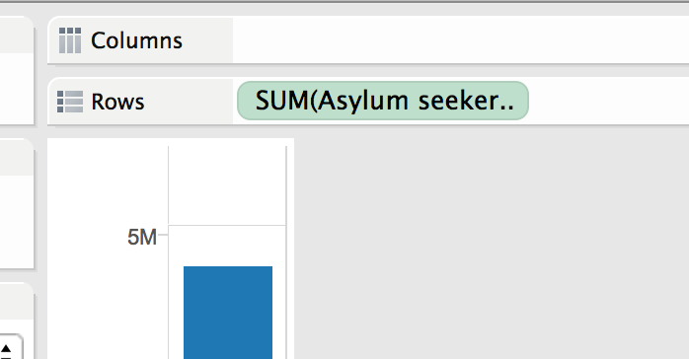
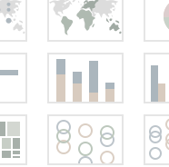
Do this: add rows
From sheet1:
You should see a “show me” box on the top RHS: click on it, then the thing that looks like a column chart (sigh: Tableau calls it “stacked bar”)
Drag “asylum seekers” from under “Measures” to the “rows” box
Notes:
Don’t panic when “asylum seekers” becomes “SUM(Asylum seekers)” in the Rows box. This is normal.

Slide 30
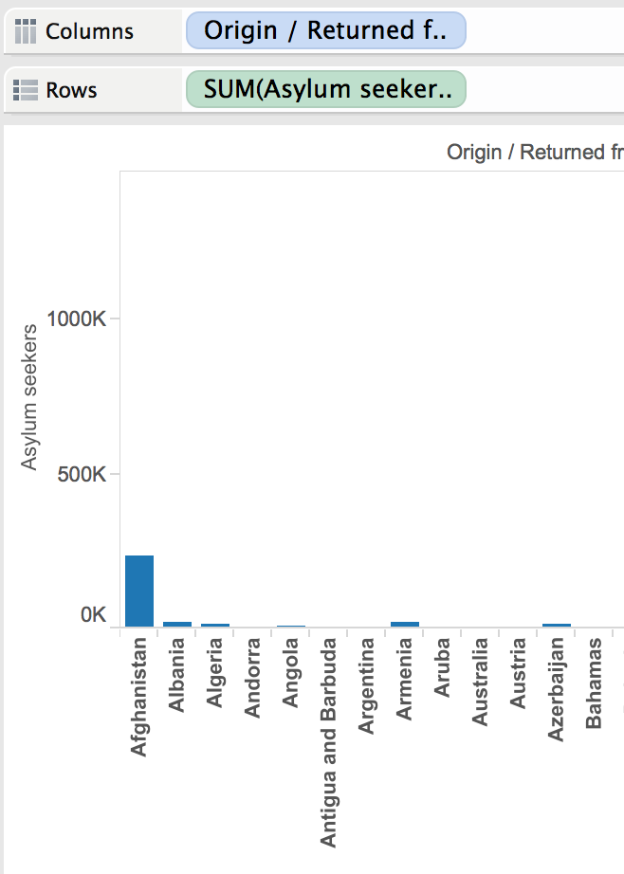
Do this: add columns
Drag “origin/ returned from” from under “dimensions” to the “columns” box
Right-click on “origin/returned from” in the “columns” box.
Click “sort…”
Click “descending”
Click “field”
Click “okay”
Notes:
At this point, you’re probably wondering why the columns are so small

Slide 31
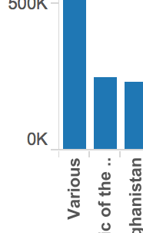
Do this: remove a column from the graph
Right-click on “various” in the graph.
Click “Exclude”
Watch the graph scale to the new biggest value (Democratic Republic of the Congo)
Notes:
Okay, “Various” is huge, and not helping the graph much. Let’s remove it.

Slide 32
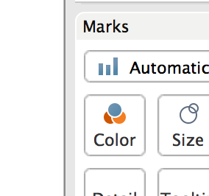
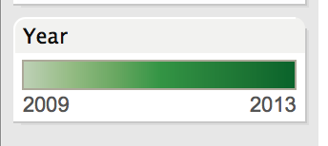
Do this: add colours
Drag “Year” to color (under “Marks”)
The green is okay, but not easy to read:
Click the little triangle that appears when you hover over the new “Year” colours box
Click “Edit colors”
Click “stepped color”
Click the bar under “Palette”; click “Red Blue Diverging” then “okay”
Notes:
The green is okay, but not easy to read.

Slide 33
A stacked column chart in Tableau
Notes:
Also available at https://public.tableau.com/profile/publish/DS_session_example/Sheet1#!/publish-confirm

Slide 34
D3 and Beyond

Slide 35
Drawing a Chord Diagram in D3: Online
Use the terminal window
cd to the directory containing file 4.3_d3_chord_online.html
In the terminal window, type:
python -m http.server 8899 &
Then go to http://0.0.0.0:8899/4.3_d3_chord_online.html in your browser
And hover your mouse over the circle edges...
(to exit, type control-c)
Notes:
This starts a webserver on your PC, that you can then go to and look at your D3 file in.
NB I changed the channel to 8899 because the standard (8888) clashes with the ipython notebook server.
Chord example is from http://bl.ocks.org/mbostock/4062006
CORRECTION: the space in the filename was making your code crash. Try again!

Slide 36
Drawing a Chord Diagram in D3: Offline
Copy your d3.js.zip file and the 4.4_d3_chord_offline.html file into a directory
Unzip d3.js.zip
In the directory your code is in, type:
python -m http.server 8899 &
Then go to http://0.0.0.0:8899/4.4_d3_chord_offline.html in your browser
And hover your mouse over the circle edges...
(to exit, type control-c)
Notes:
The difference between the two files is in where the D3 code comes from.
In the online version, the D3 code is at //d3js.org/d3.v3.min.js (the d3.v3.min.js file is a version of d3.js with all the whitespace and comments taken out to make it smaller);
In the offline version, the D3 code is on your pc, in file d3.js the d3 directory.
Bugz: you might get an error message saying “Address already in use”. This is bad and naughty, but to quickly fix it, try:
in the terminal window, type “ps -a”
Note the number at the left of the line that looks like “7064 ttys000 0:00.16 python -m http.server 8899”
type “kill -9 7064” (or whatever your number was).
Note: this is a very powerful command: make sure you’re using the right number, or you might accidentally shut down your machine…

Slide 37
That chord diagram

Slide 38
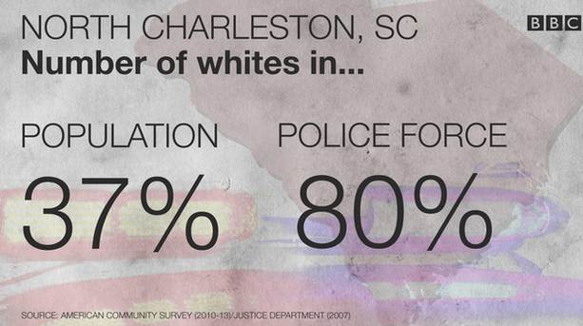
Communication doesn’t have to be complex

Slide 39
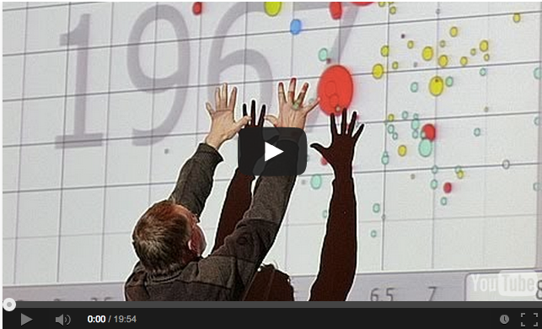
Communication doesn’t have to be “standard”
Notes:
Image: Hans Rosling video.

Slide 40
Exercises

Slide 41
Exercise: Design your visuals
Use pen and paper (or post-its) to design visualisations and dashboards for your project

